Slide 1
Class 7: Poissin/NegBin regression
Kim Johnson

Slide 2
Lecture Outline
Count data
The Poisson distribution
The Poisson regression model
The negative binomial regression model
Comparisons between Poissin and negbin
Interpretations

Slide 3
Learning Objectives
Be able to understand when to use Poisson or negative binomial regression
Understand how to run these models in R
Know how to interpet model results

Slide 4
Count data
The outcome variable is a count or the number of times an event has happened
Examples:
Number of times using a service (visiting a doctor, hospitalization)
Daily homicides
Number of beverages consumed
Number of police arrests
Cancer rates
Car accidents
Genetic mutations
The primary feature of a count variable is that it has a skewed distribution (as compared to a normal distritubtion)

Slide 5
Ordinary least squares (i.e. linear regression)
Cannot apply OLS to a count variable because it violates the normality assumption, most count variables do not have a normal distribution

Slide 6
Models that deal with count outcomes:
The Poisson regression model: the probability of a count is determined by the Poisson distribution. The model has a defining characteristic that the conditional mean of the outcome is equal to the conditional variance.
The negative binomal regression model: needed when the conditional variance (the variance in the expected mean counts given x variables) exceeds the conditional mean (the expected mean counts given x variables).
Other models for other violations (not considered here): zero-truncated models (few or no 0 counts), hurdle regression models (lots of zero counts), zero-inflated models (lots of zero counts).

Slide 7
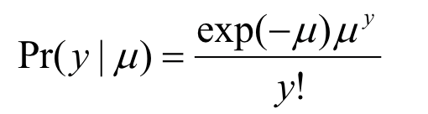
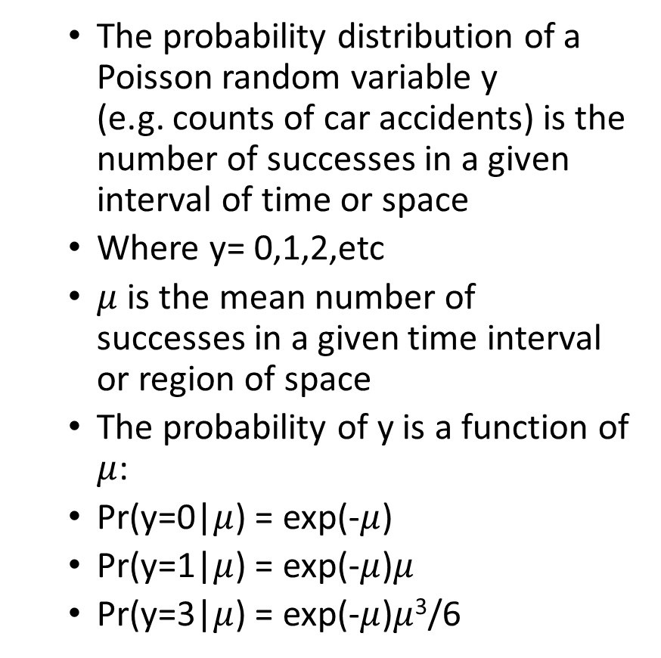
The Poisson distribution
The probability distribution of a Poisson random variable y (e.g. counts of car accidents) is the number of successes in a given interval of time or space
Where y= 0,1,2,etc
$μ$ is the mean number of successes in a given time interval or region of space
The probability of y is a function of $μ$:
Pr(y=0|$μ$) = exp(-$μ$)
Pr(y=1|$μ$) = exp(-$μ$)$μ$
Pr(y=3|$μ$) = exp(-$μ$)$μ$³/6

Slide 8
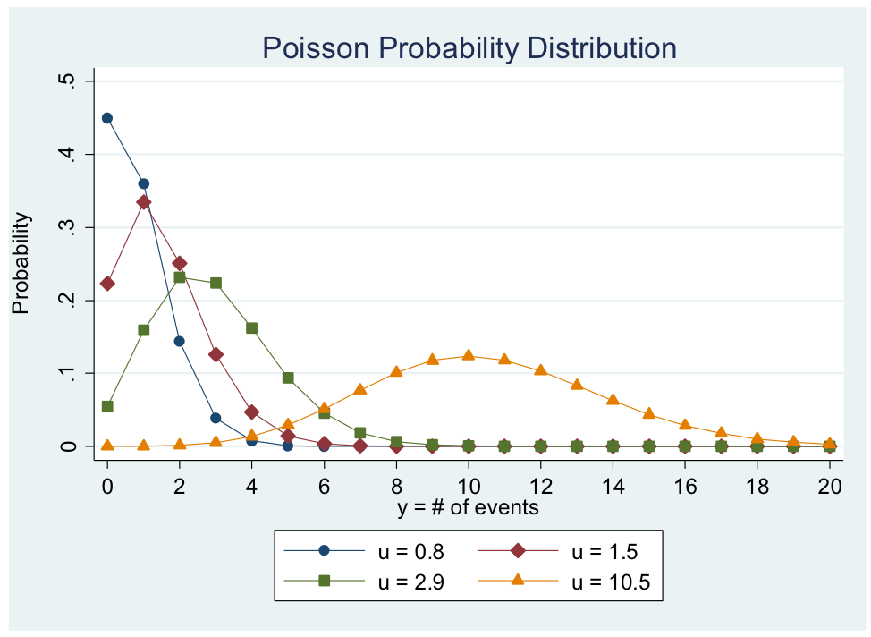
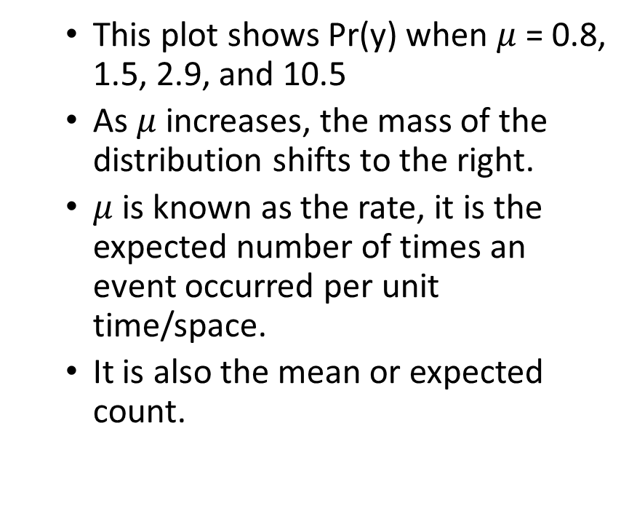
The Poisson distribution
This plot shows Pr(y) when $μ$ = 0.8, 1.5, 2.9, and 10.5
As $μ$ increases, the mass of the distribution shifts to the right.
$μ$ is known as the rate, it is the expected number of times an event occurred per unit time/space.
It is also the mean or expected count.

Slide 9
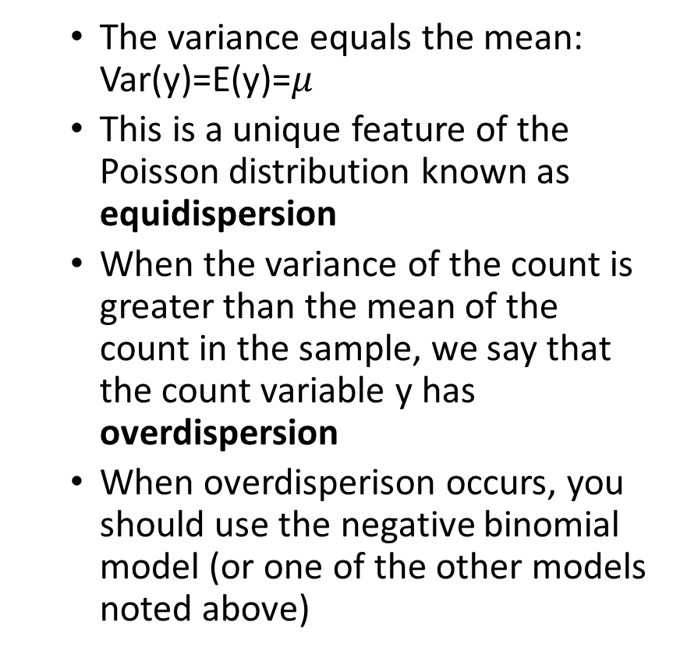
The Poisson distribution
The variance equals the mean: Var(y)=E(y)=$μ$
This is a unique feature of the Poisson distribution known as equidispersion
When the variance of the count is greater than the mean of the count in the sample, we say that the count variable y has overdispersion
When overdisperison occurs, you should use the negative binomial model (or one of the other models noted above)

Slide 10
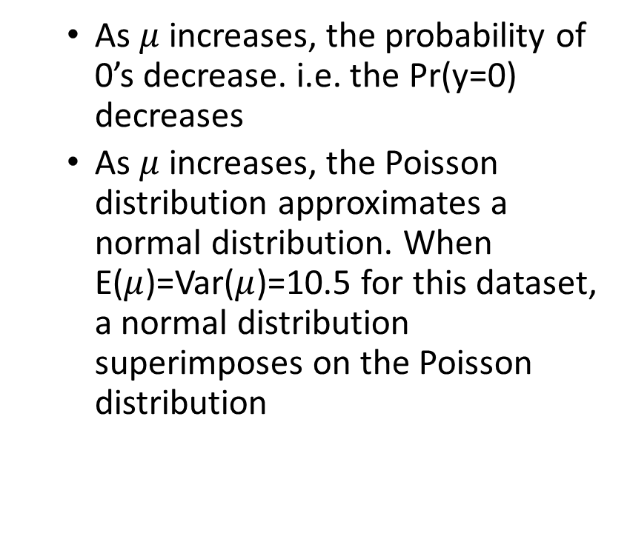
The Poisson distribution
As $μ$ increases, the probability of 0’s decrease. i.e. the Pr(y=0) decreases
As $μ$ increases, the Poisson distribution approximates a normal distribution. When E($μ$)=Var($μ$)=10.5 for this dataset, a normal distribution superimposes on the Poisson distribution

Slide 11
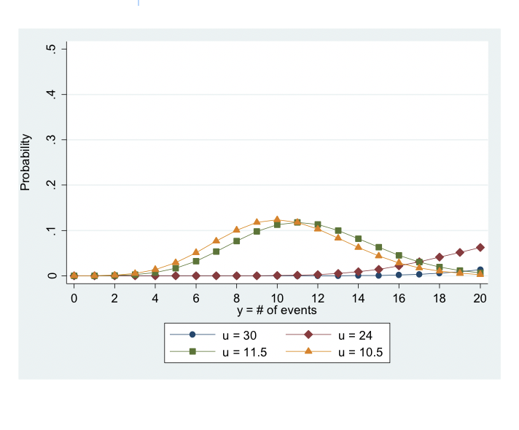
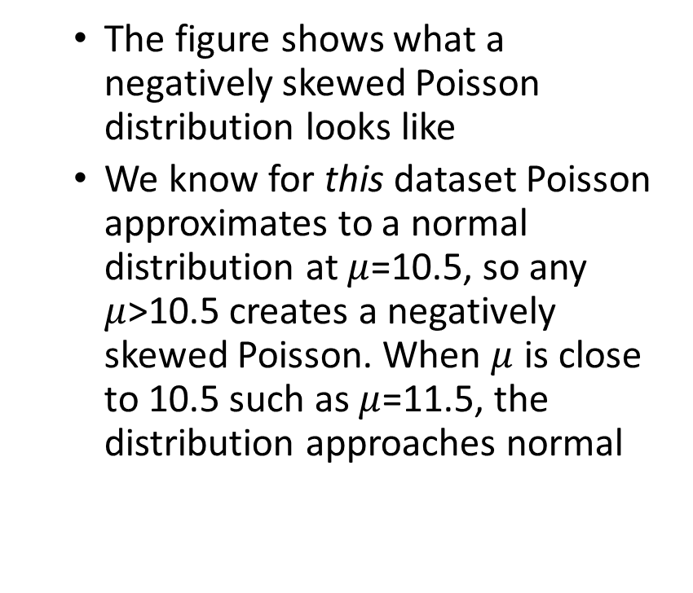
The Poisson distribution
The figure shows what a negatively skewed Poisson distribution looks like
We know for this dataset Poisson approximates to a normal distribution at $μ$=10.5, so any $μ$>10.5 creates a negatively skewed Poisson. When $μ$ is close to 10.5 such as $μ$=11.5, the distribution approaches normal

Slide 12
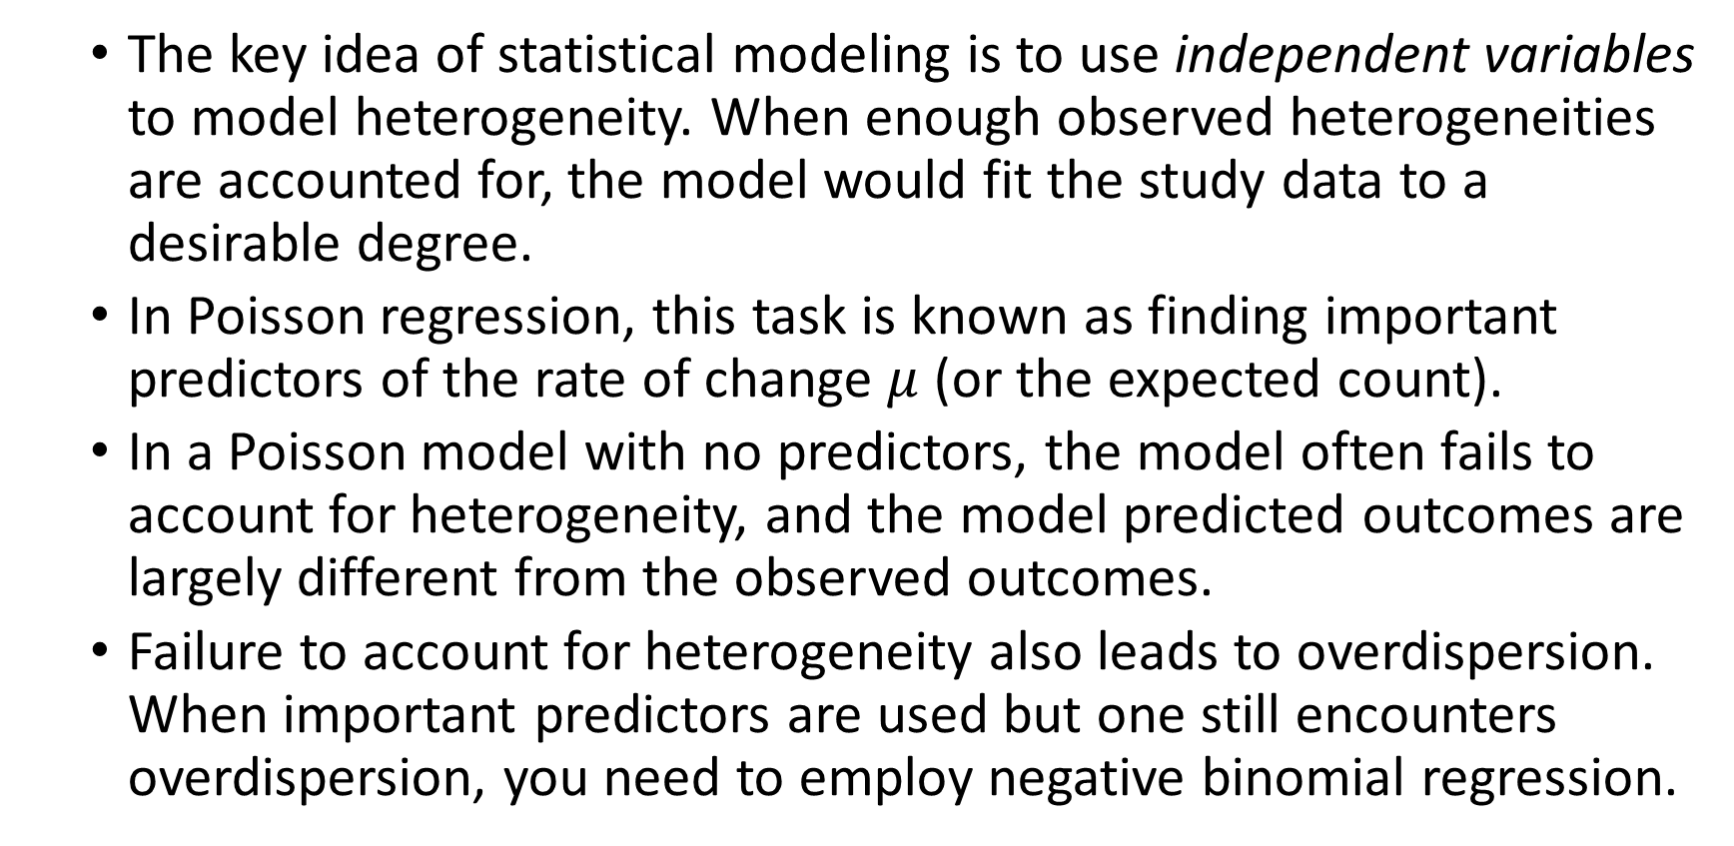
Heterogeneity
The key idea of statistical modeling is to use independent variables to model heterogeneity. When enough observed heterogeneities are accounted for, the model would fit the study data to a desirable degree.
In Poisson regression, this task is known as finding important predictors of the rate of change $μ$ (or the expected count).
In a Poisson model with no predictors, the model often fails to account for heterogeneity, and the model predicted outcomes are largely different from the observed outcomes.
Failure to account for heterogeneity also leads to overdispersion. When important predictors are used but one still encounters overdispersion, you need to employ negative binomial regression.

Slide 13

The link function for Poisson
Take a logarithm transformation of $μ$
The logarithm of the mean count is modeled as a linear combination of the unknown parameters (the $β$s that are estimated by MLE)

Slide 14
The link function for Poisson

Slide 15
Poisson model specification (expected mean count given x variables)

Slide 16
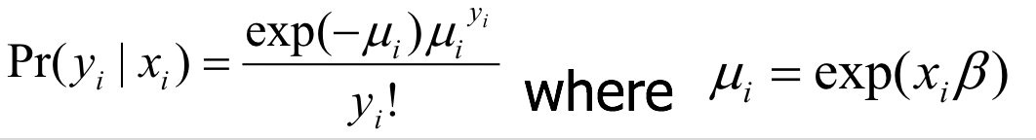
The below formula will give you the predicted probability

Slide 17
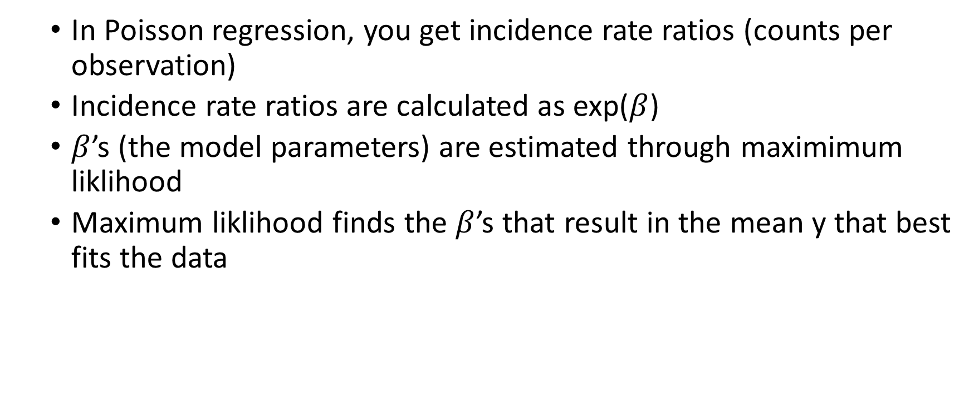
Poisson regression output
In Poisson regression, you get incidence rate ratios (counts per observation)
Incidence rate ratios are calculated as exp($β$)
$β$’s (the model parameters) are estimated through maximimum liklihood
Maximum liklihood finds the $β$’s that result in the mean y that best fits the data

Slide 18
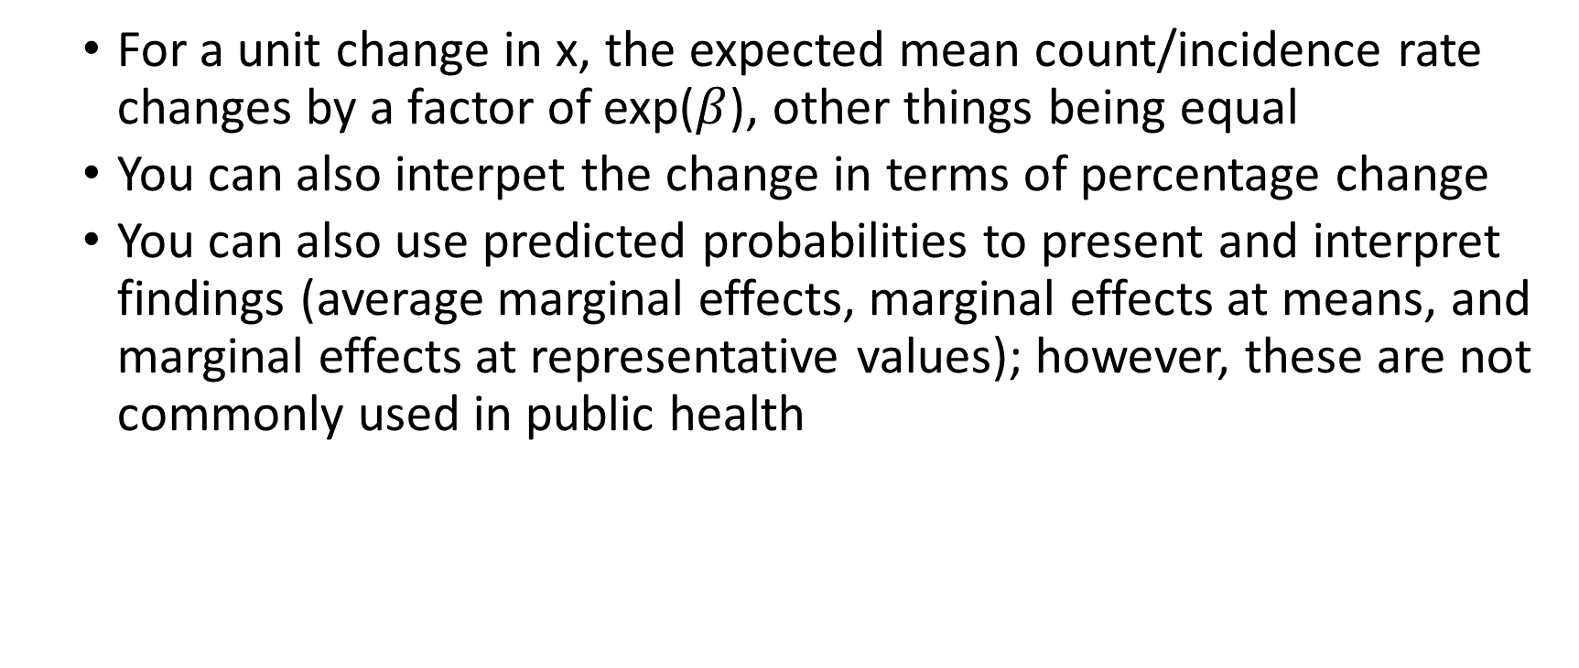
Interpretation
For a unit change in x, the expected mean count/incidence rate changes by a factor of exp($β$), other things being equal
You can also interpet the change in terms of percentage change
You can also use predicted probabilities to present and interpret findings (average marginal effects, marginal effects at means, and marginal effects at representative values); however, these are not commonly used in public health

Slide 19
A word about offsets
The poisson model (and negative binomial model next) predict the log counts per individual given x’s
Sometimes you want to account for exposure time or population size
When you have group level data, like states, you need to account for size of the population
You may want to account for exposure time in some analyses such as amount of time a person has been smoking to get the incidence rate of lung cancer as we will do in the example
To do this you need to include an offset in the model, which is the log (population) or log (time)

Slide 20
The negative binomial regression model
The assumption that the conditional variance = the conditional mean in Poisson rarely holds. There is often overdispersion. In this scenario the negative binomial (negbin) model can be used.
To address the problem of overdispersion, the negbin model adds a parameter (so called overdispersion parameter) that allows the conditional variance of y to exceed the conditional mean.

Slide 21
The negative binomial regression model
Overdispersion is when the observed variance in the response y is higher than the variance in the response y from the theoretical model. The consequence of this is that the estimated standard errors will be wrong (biased low) and the p-values will be too low, potentially leading to type 1 errors.
The motivation of adding this parameter is to model unobserved heterogeneity.
Notes:
If SE is too small, you can have inflated p-values and then get more type I errors; this can cause us to jump to causation too quickly.

Slide 22
The negative binomial model specification

Slide 23
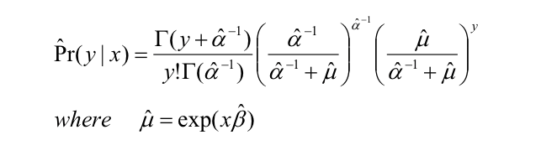
You can calculate model predicted probabilities with the below formula:

Slide 24
Robust standard errors
Because of overdispersion, the standard error in both Poisson regression and negbin regression may be downwardly biased (inflating p-values). As a convention, to correct for this we can use robust standard errors.

Slide 25
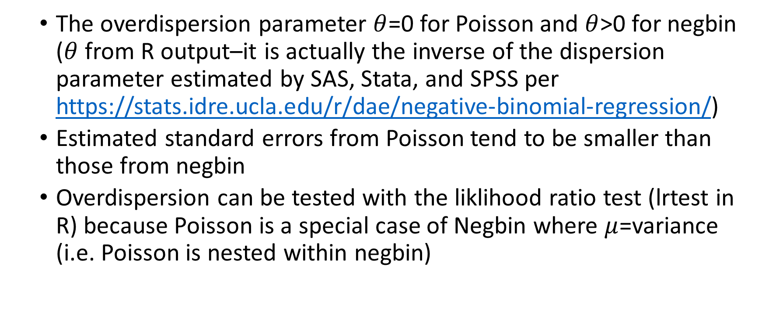
Comparisons between Poisson and negbin
The overdispersion parameter $θ$=0 for Poisson and $θ$>0 for negbin ($θ$ from R output–it is actually the inverse of the dispersion parameter estimated by SAS, Stata, and SPSS per https://stats.idre.ucla.edu/r/dae/negative-binomial-regression/)
Estimated standard errors from Poisson tend to be smaller than those from negbin
Overdispersion can be tested with the liklihood ratio test (lrtest in R) because Poisson is a special case of Negbin where $μ$=variance (i.e. Poisson is nested within negbin)

Slide 26
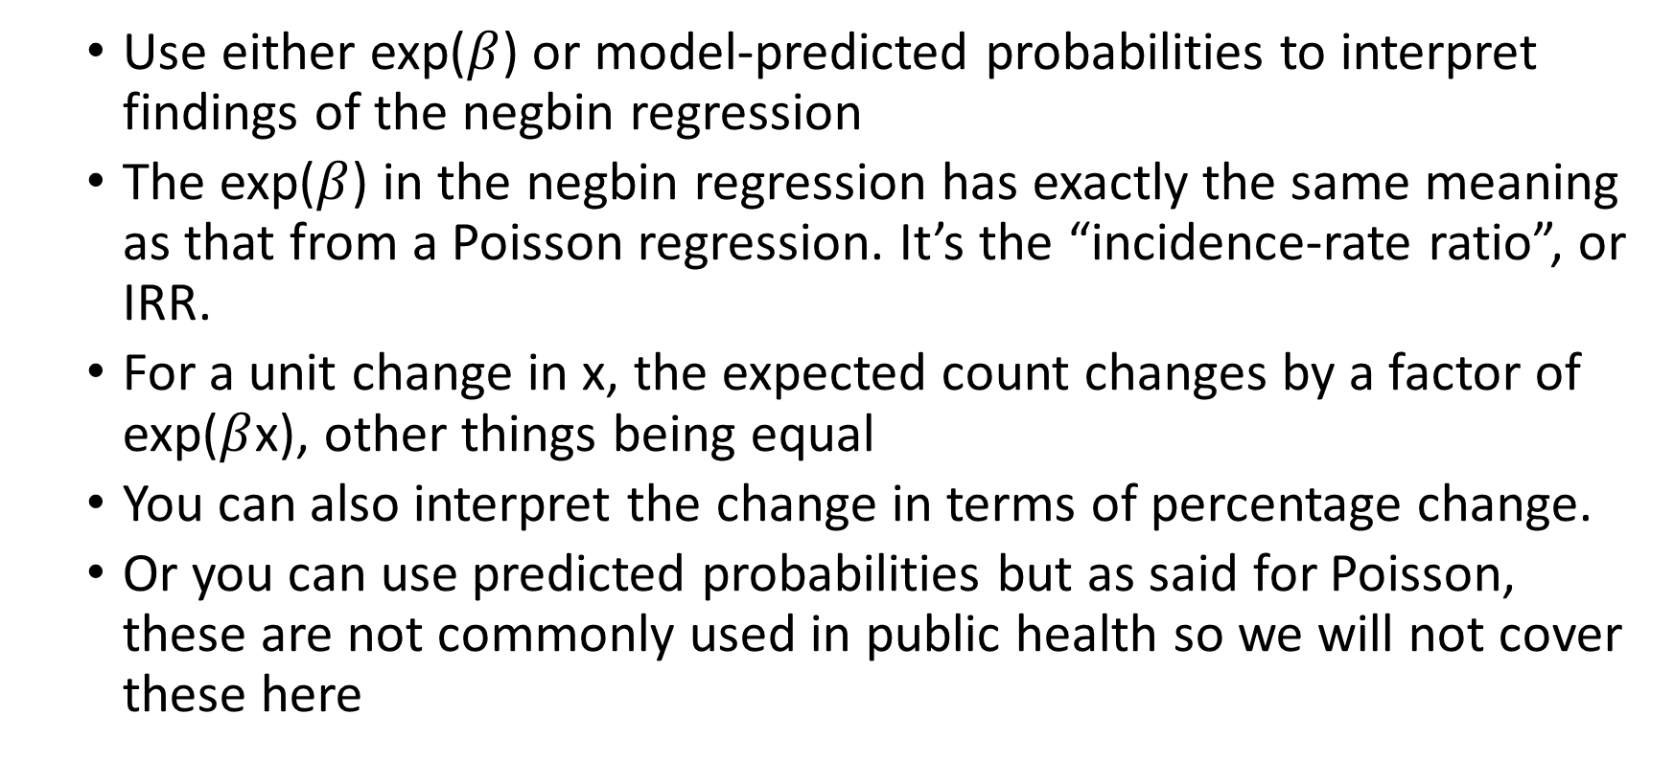
Interpretations of negbin
Use either exp($β$) or model-predicted probabilities to interpret findings of the negbin regression
The exp($β$) in the negbin regression has exactly the same meaning as that from a Poisson regression. It’s the “incidence-rate ratio”, or IRR.
For a unit change in x, the expected count changes by a factor of exp($β$x), other things being equal
You can also interpret the change in terms of percentage change.
Or you can use predicted probabilities but as said for Poisson, these are not commonly used in public health so we will not cover these here
Notes:
Interpretation of results is the same as poison

Slide 27
Skin and lung cancer examples demo
Applied Regression Analysis and Multivariable Methods, 4th Edition.
[https://rpubs.com/kaz_yos/poisson]

